Slide 1
Presentation 3
Thinkers

Slide 2
Objectives
Why is the epithelium width calculated by our algorithm different from the actual width of the epithelium?
Calculate epithelium width locally instead of globally
Make code more efficient

Slide 3
Question:
Answer:
Why is the epithelium width calculated by our algorithm different from the actual width of the epithelium?
In our epithelium width calculation we were taking a slice of an entire column, which hits the epithelium twice and messing up our calculations
We no longer use the max width for an entire slice, but we look all the sections in each slice separately

Slide 4
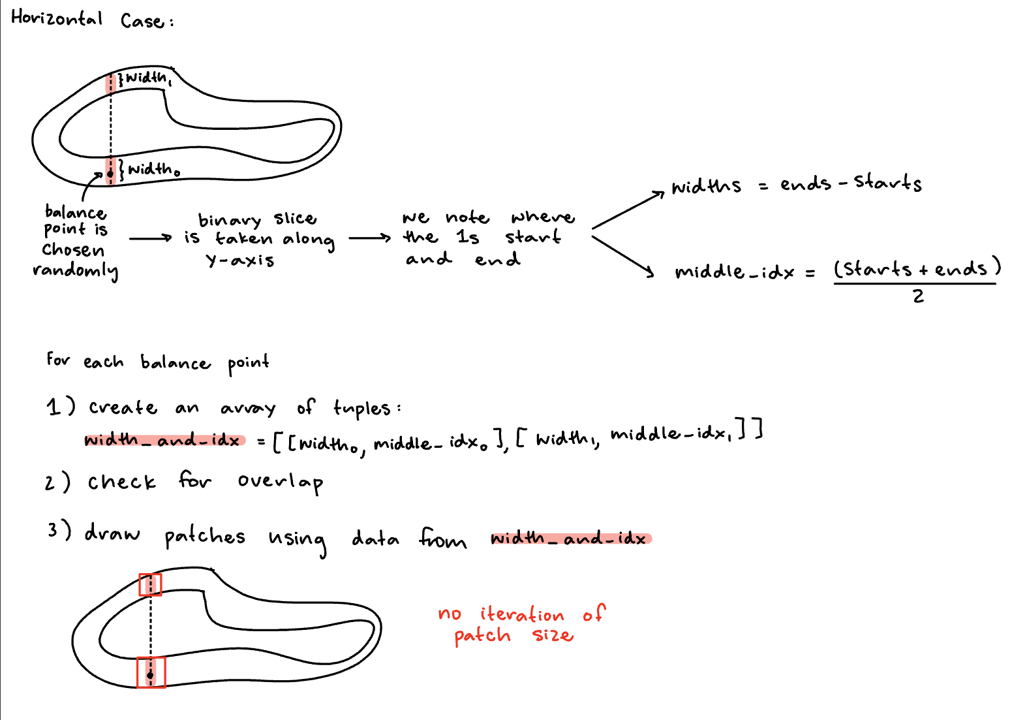
Updated Width Calculation - horizontal example

Slide 5
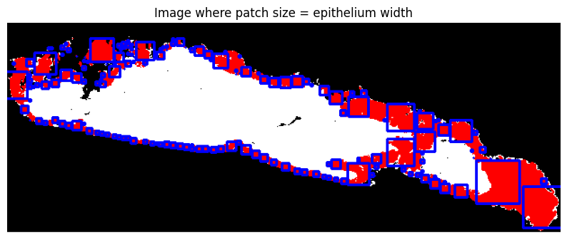
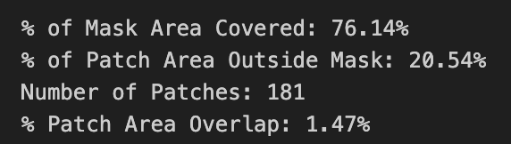
Results
Patch dimensions match the epithelium width well
The patches cover less of the total epithelium because of this (previously ~86%)
But lower patch area outside mask (previously ~40%)
Solution:
Multiply width by 1.1 and round up to nearest integer

Slide 6

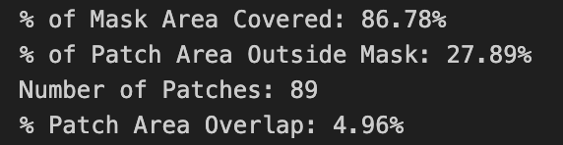
Updated Results
Metrics look good
Takes 1 second to run, which is longer than Alyssa’s code with the patch size iterations
Optimizing this code is a work in progress
This code still determines orientation globally, not locally

Slide 7
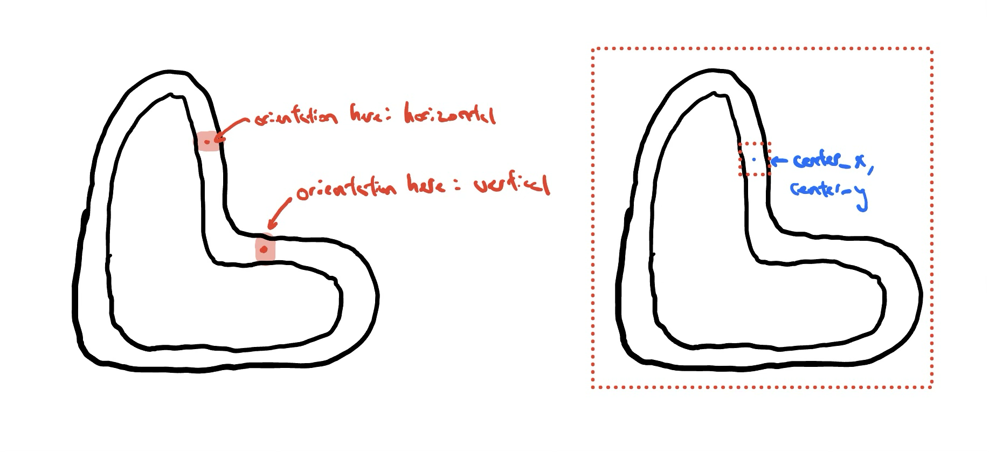
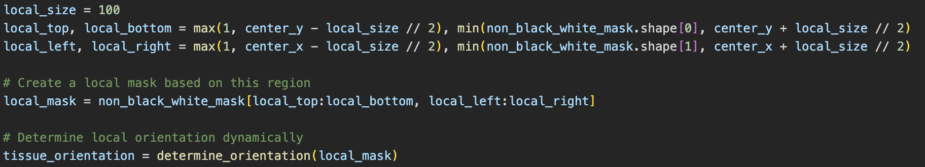
Why local orientation?

Slide 8
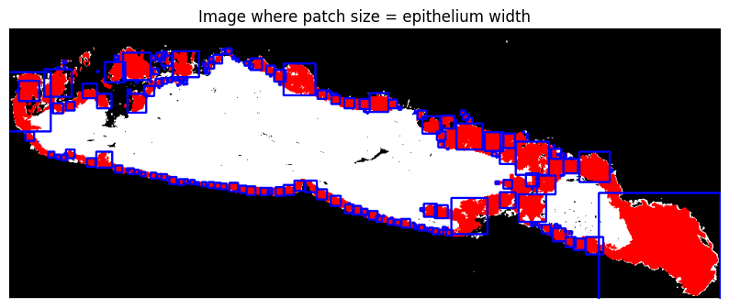

With local orientation
Metrics look marginally better than without (+ 3% mask covered and - 2% outside covered)
Almost x2 number of patches
+2% more overlap

Slide 9
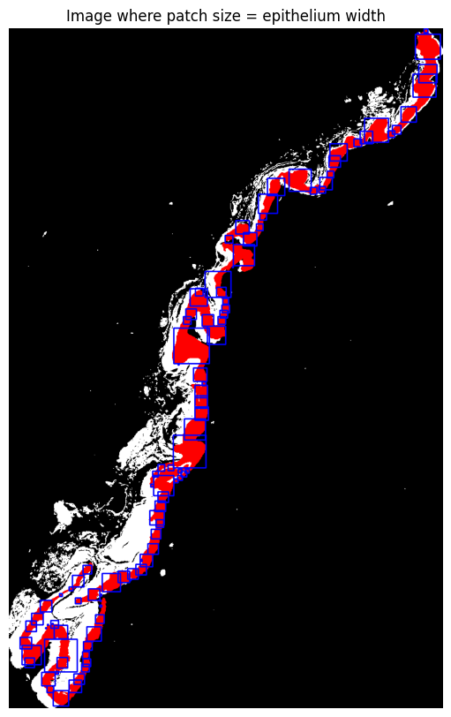
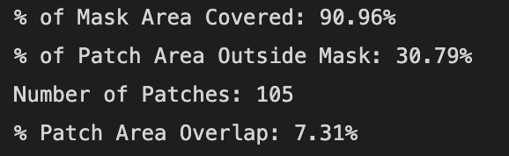
Generalizes well

Slide 10
Creating More Test Cases
To help test out the code we need more PNGs that have the epithelium annotated
Requires manually annotating the epithelium on Qupath and using a script to extract the annotations into a PNG file
Cases are stored in a shared file so that anyone in the team can use it for their testing
A sheet organizing the cases that have been annotated and put in the shared file was created to organize and keep track of which ones were done

Slide 11
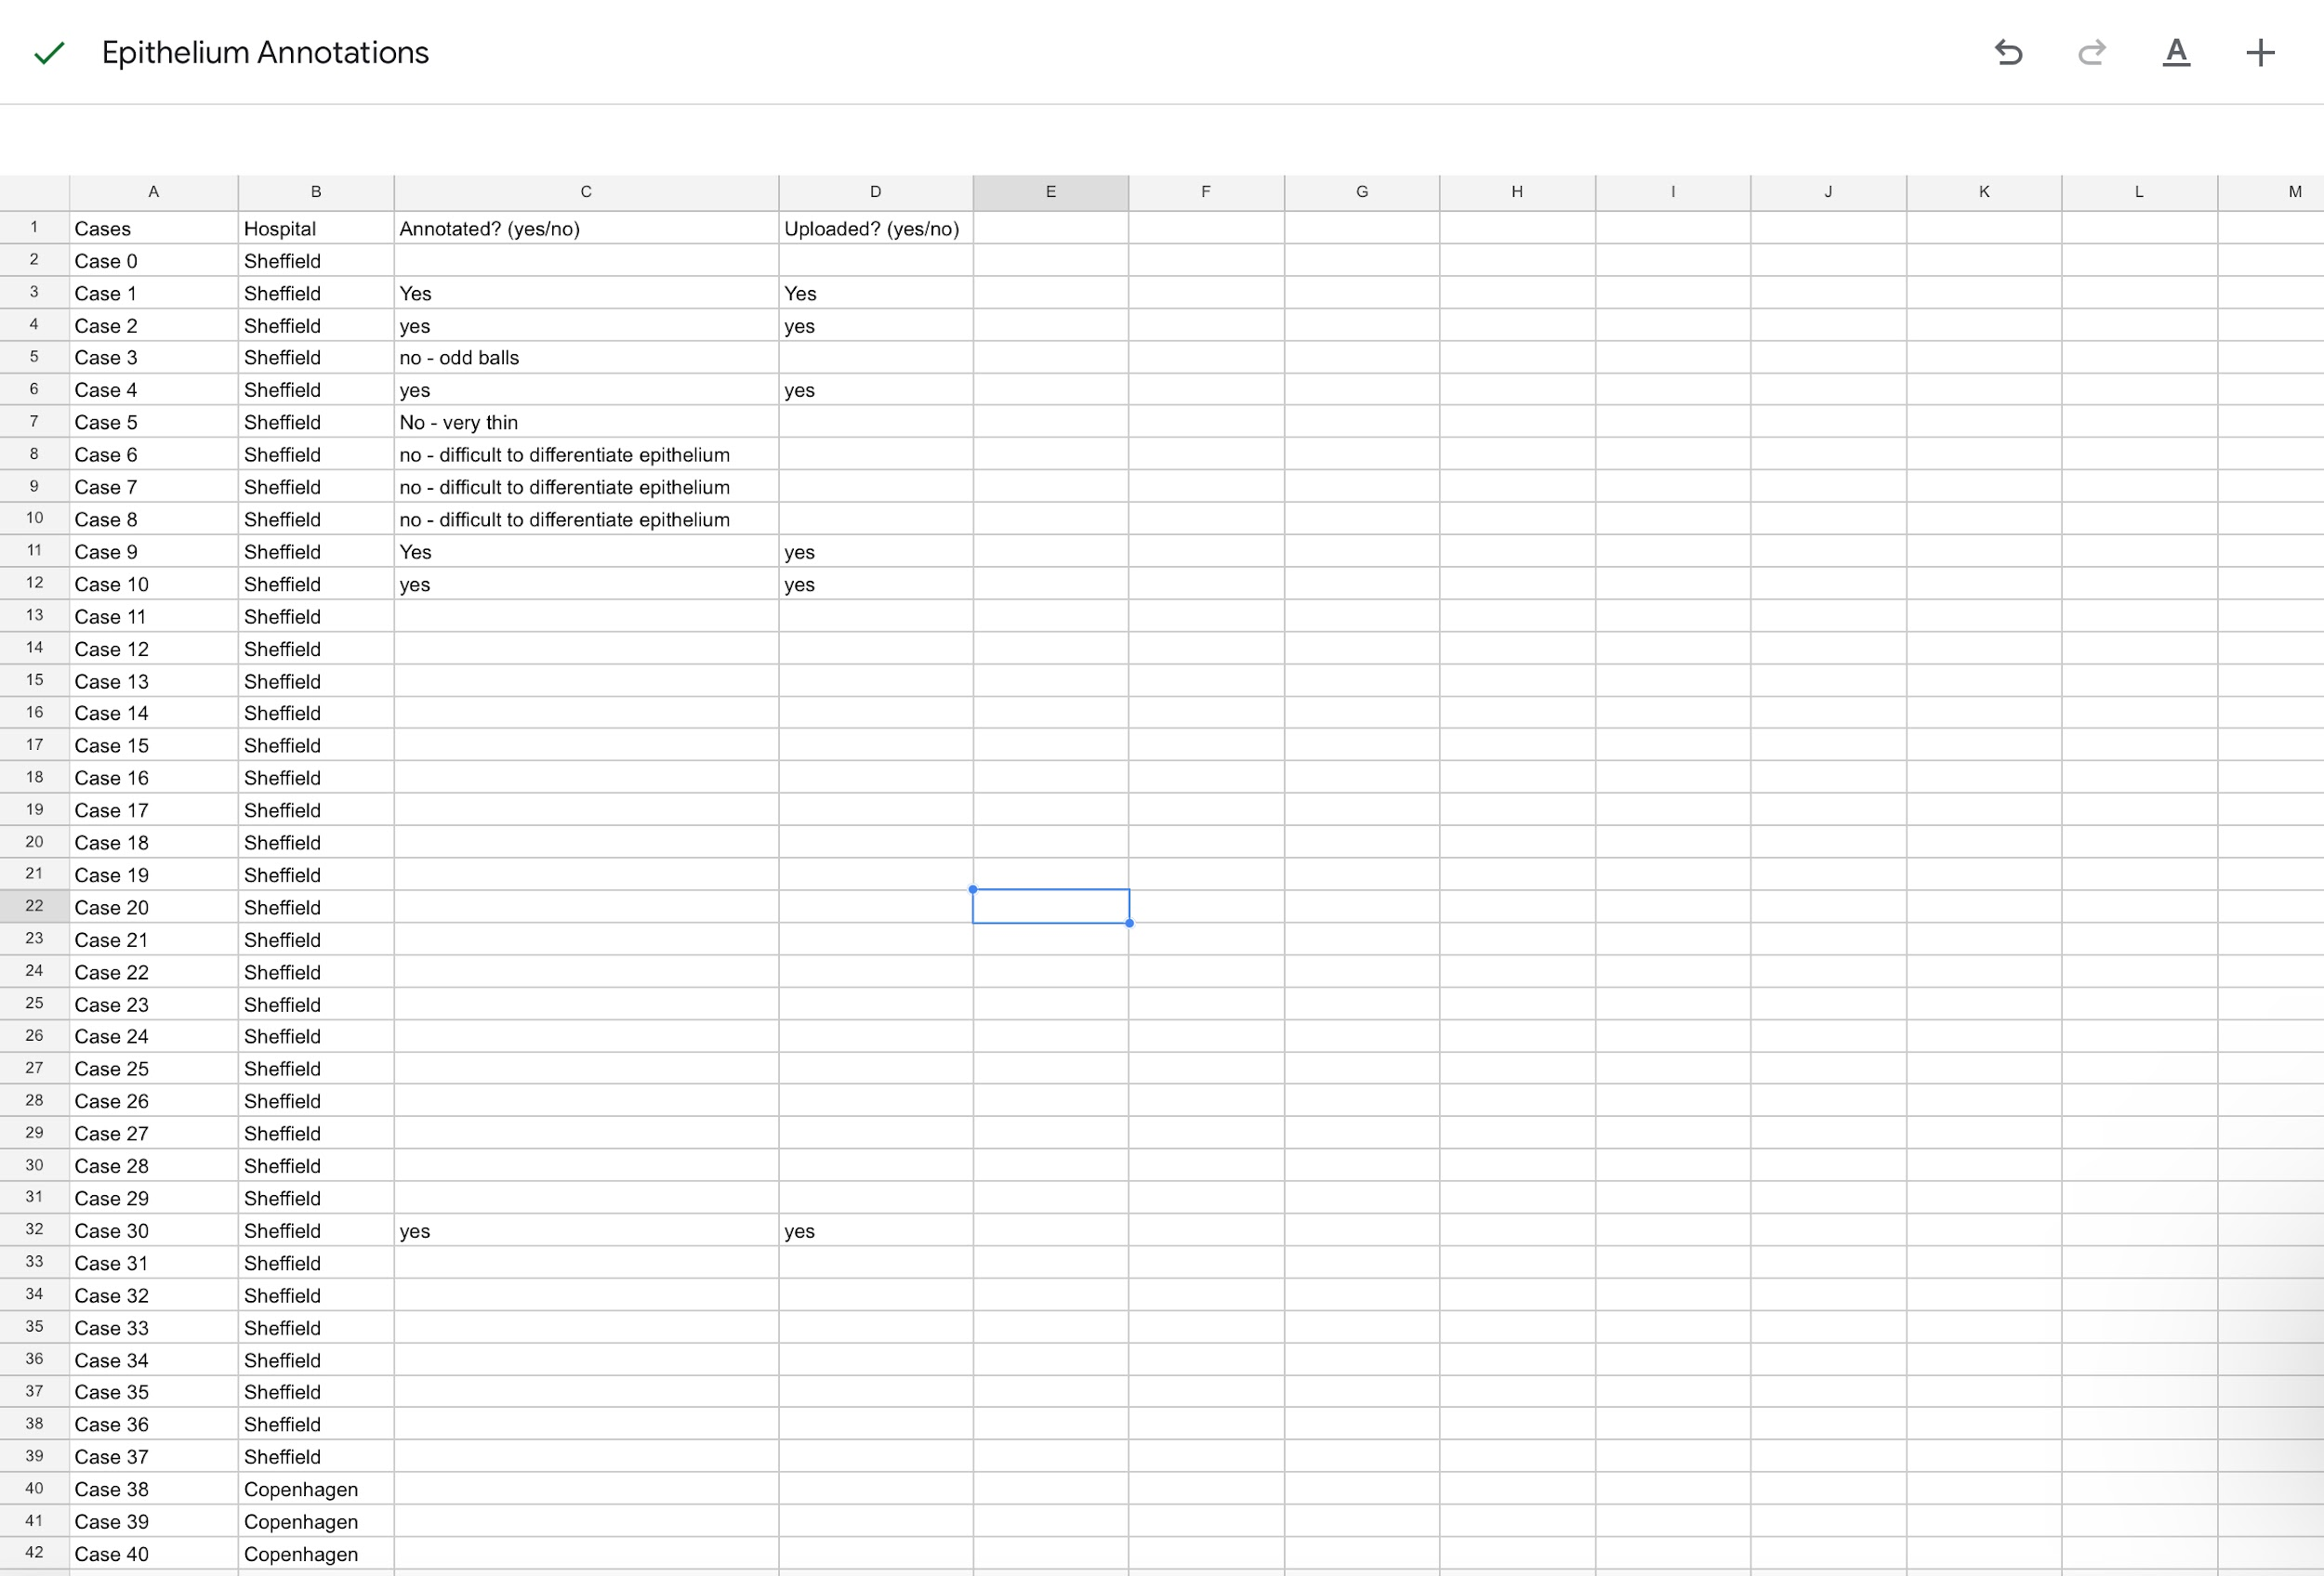
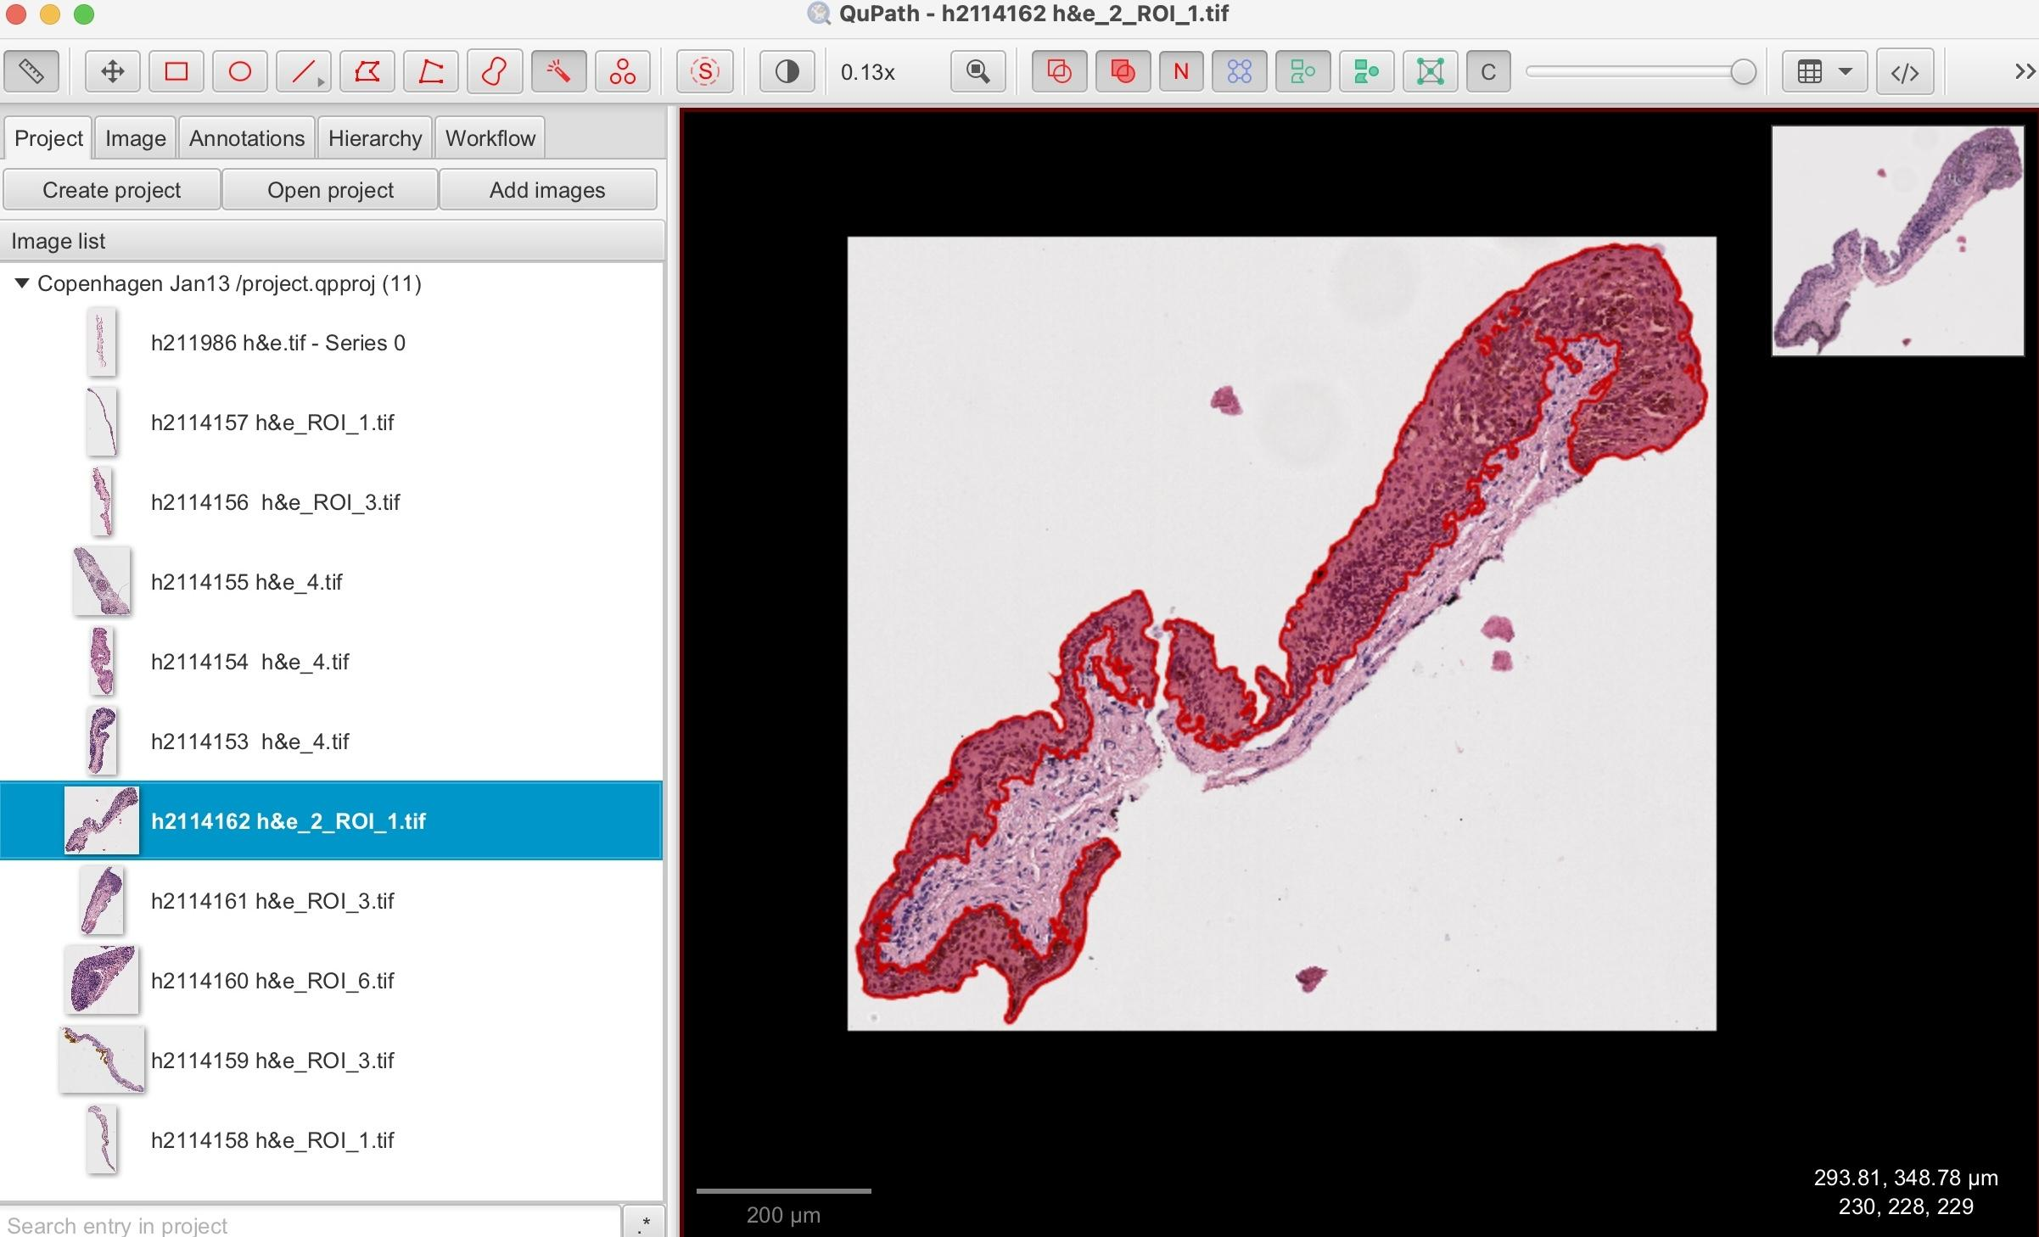
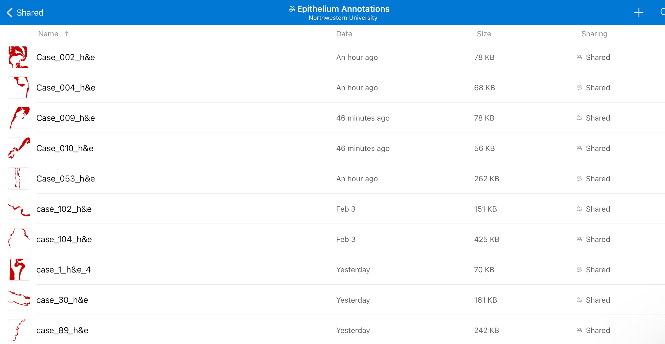
Observations:
In some cases, it was hard to differentiate the epithelium
Cases when the epithelium is very small or non-existent making it hard to determine if it is part of the epithelium

